Slide 1

Netflix Data Analysis
Presented By
Synsharlang Wahlang

Slide 2

Introduction
Netflix is a global streaming service offering movies, shows, and originals. Founded in 1997, it transformed entertainment with online streaming and is known for hit content like Stranger Things and Squid Game.

Slide 3
Objectives
Analyze customer demographics and subscription types
Identify most popular and top-rated content
Explore viewing behavior by age group and region
Assess subscription type impact on engagement
Compare content performance by genre, director, and cast
Develop interactive dashboards for business insights

Slide 4
Business Uses
Identify popular content
Understand audience preferences
Analyze subscription performance
Track customer engagement
Support data-driven decisions

Slide 5
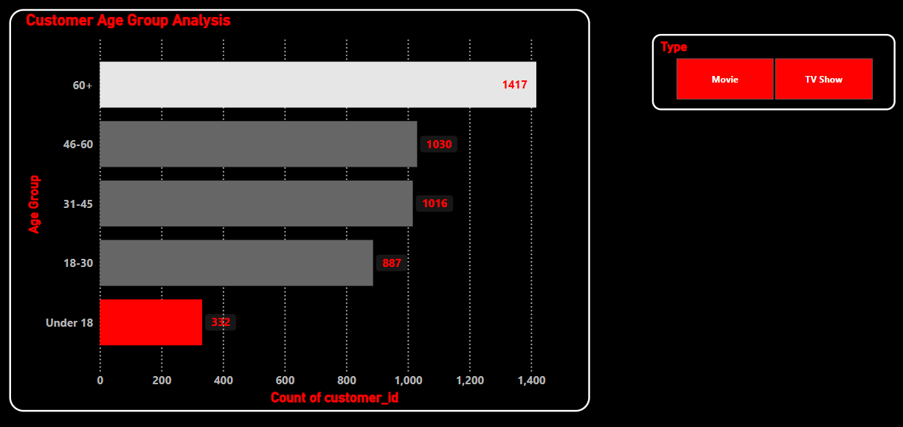
Customer Age Group Analysis

Slide 6
60+ age group has the highest watch time on Netflix.
Indicates strong engagement from senior viewers.
Recommendation: Launch a curated “Golden Prime” collection targeting the 60+ segment.
Under-18 age group shows the lowest watch time on Netflix
Insights:
Improve parental controls and kid-friendly features.
Focus on creating engaging youth content and marketing on teen platforms.

Slide 7
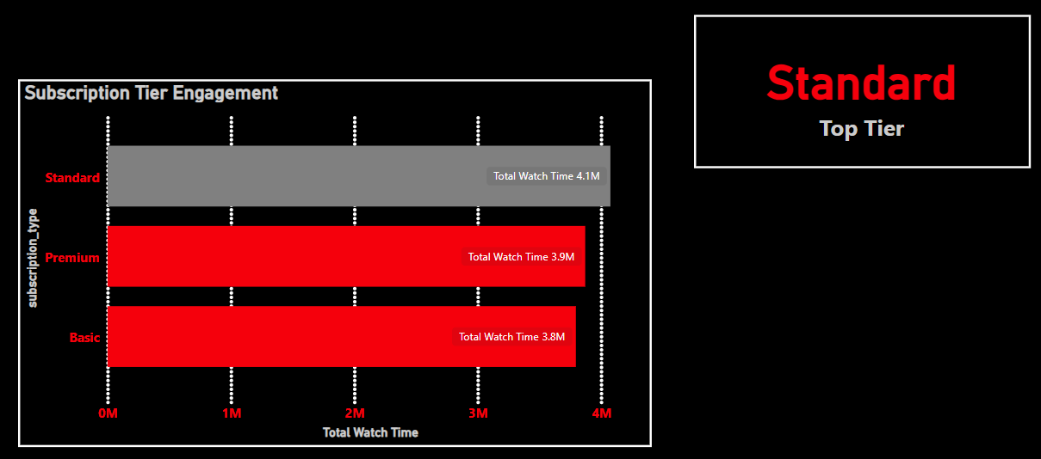
Subscription Tier Engagement

Slide 8
Standard subscription has the highest watch time (4.1M), showing strong user engagement.
Basic subscription has the lowest watch time, indicating limited usage.
Insights:
Standard plan balances price and features, driving high engagement.
Upsell Basic users by promoting Standard benefits.
Improve Basic plan features to reduce churn and boost watch time.

Slide 9
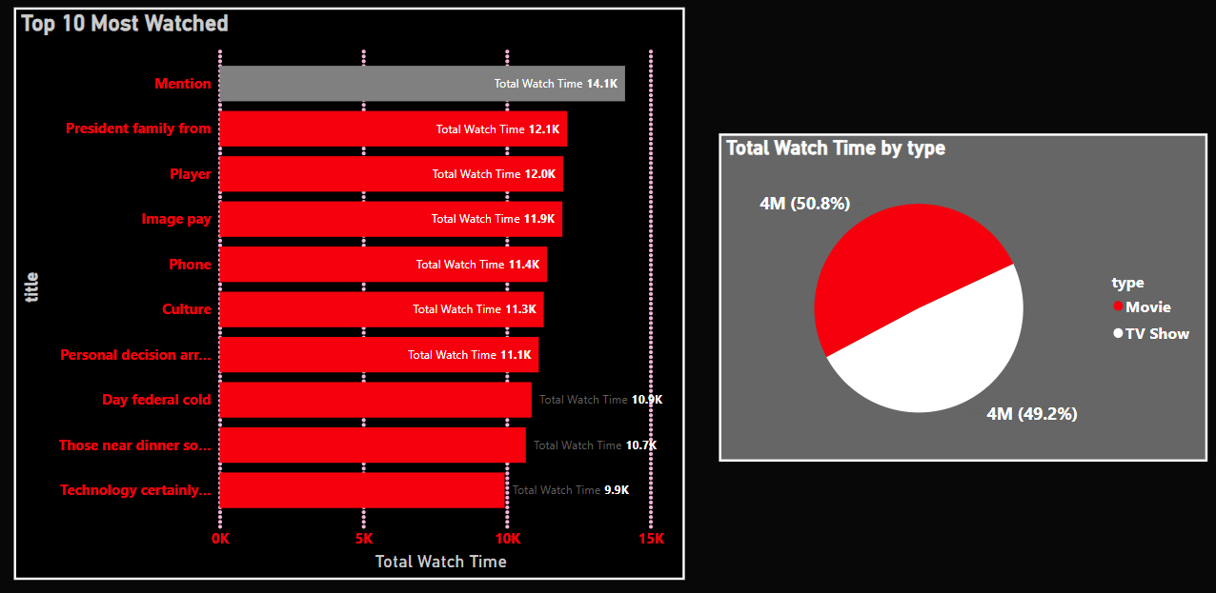
Top 10 Most Watched

Slide 10
Movies have higher watch time than TV shows, showing viewer preference.
Top movie leads engagement, showing blockbuster potential.
Business Insights:
Invest in quality movies to attract viewers.
Use hits as a model for new content.
Promote TV shows to boost their watch time.
Highlight popular movies in marketing to increase subscriptions.

Slide 11
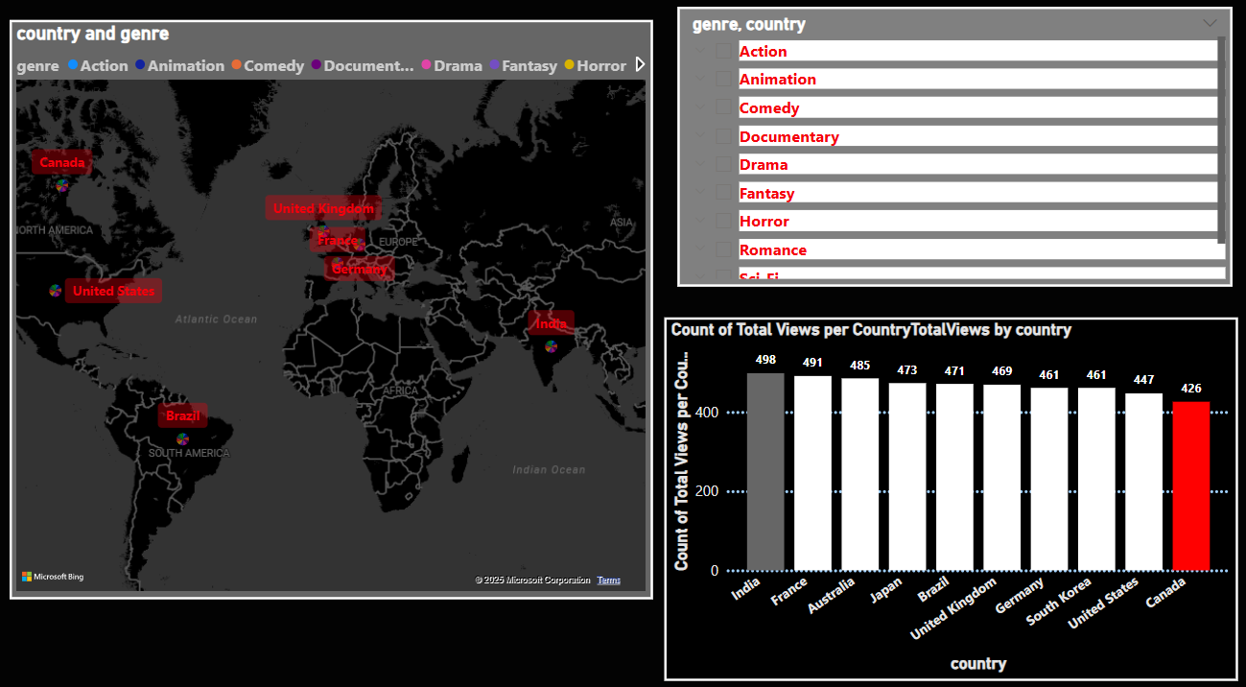
Genre Trends by Country

Slide 12
India leads in viewers, especially for the Drama genre, showing strong content demand.
Canada has low engagement and no top genre, indicating opportunity for growth.
Business Insights:
For India, focus on expanding and promoting Drama and similar popular genres.
For Canada, explore local preferences and introduce tailored content to boost engagement.

Slide 13
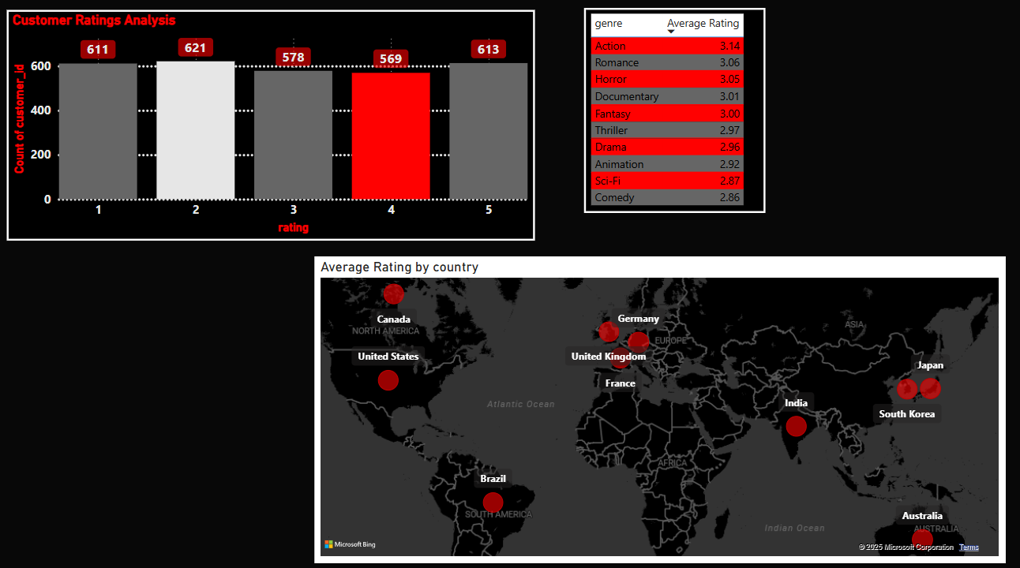
Customer Ratings Analysis

Slide 14
Japan has the highest ratings, especially for horror shows.
France has the lowest ratings, indicating room for improvement.
Action movies get the highest average ratings across all countries.
Business Insights:
Invest more in horror content for Japan’s strong audience.
Enhance content quality and localization in France to boost ratings.
Focus on producing and promoting action movies globally for wider appeal.

Slide 15
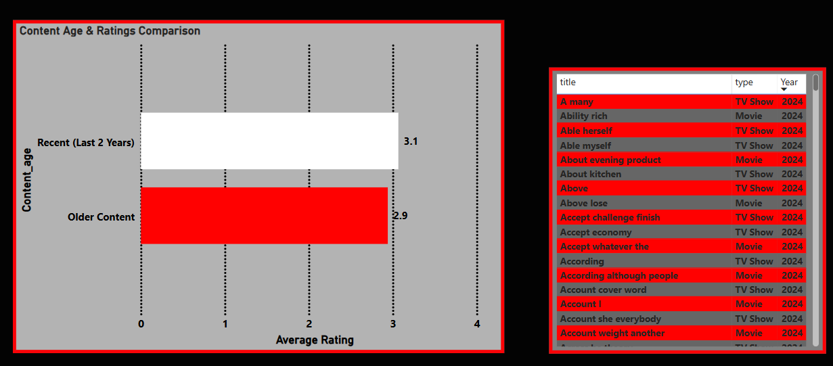
Content Age & Ratings Comparison

Slide 16
Insights:
Recent content (last 2 years) has the highest average rating (3.1) — showing strong viewer approval.
Older content receives lower ratings — indicating reduced relevance or quality.
Business Impact:
Invest more in new, high-quality content to keep engagement high.
Revamp or promote older content (e.g., through remastering or themed collections) to increase its appeal.

Slide 17
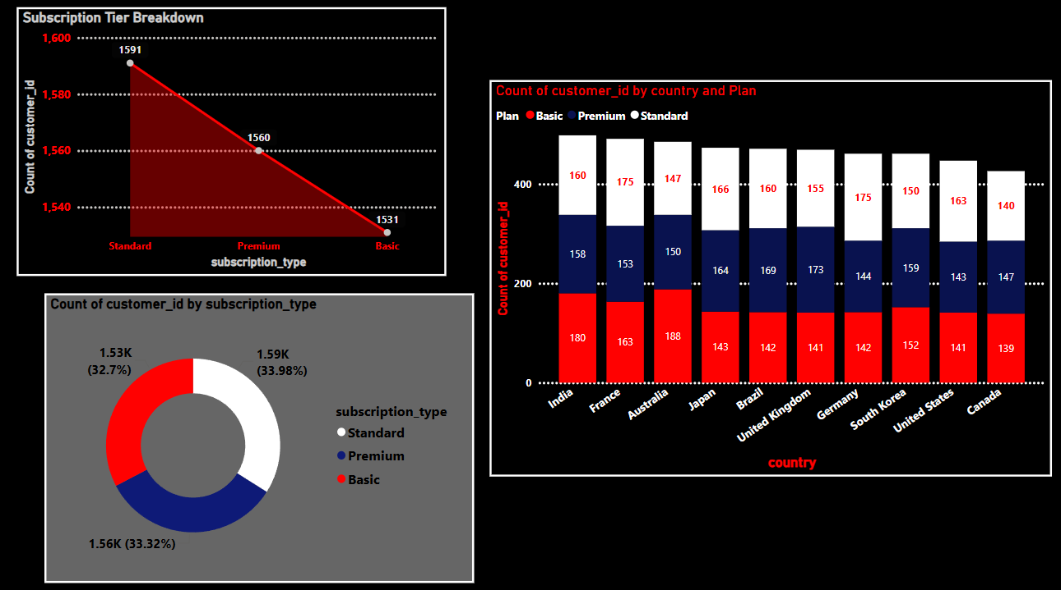
Subscription Tier Breakdown

Slide 18
Insights:
India leads in overall subscriptions — strong market presence.
Standard plan is most popular (33.98%), especially in Japan.
Basic plan has the lowest share (32.7%) — may lack perceived value.
Business Impact:
Focus marketing and content strategies in India to strengthen market dominance.
Promote Standard plan globally by highlighting its value (HD, multiple screens).
Enhance or reposition Basic plan to boost its adoption or shift users to higher tiers.

Slide 19
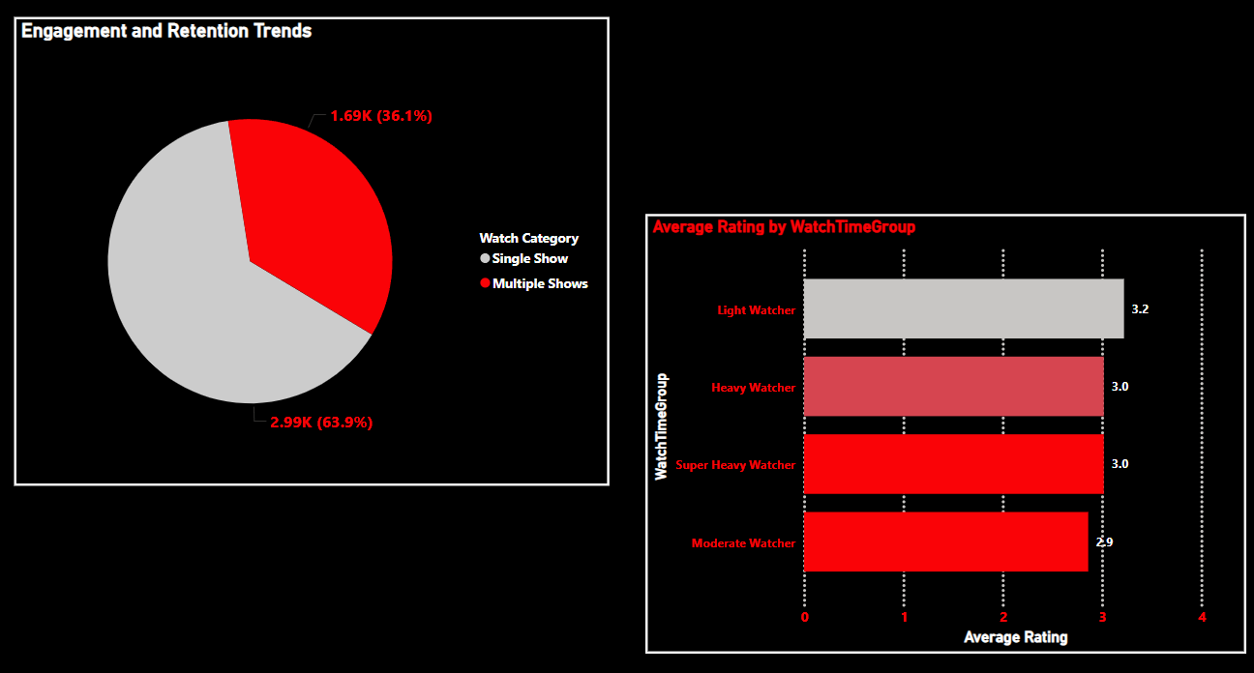
Engagement and Retention Trends

Slide 20
Majority of users prefer watching a single show (2.29K vs. 1.69K for multiple shows).
Lighter watchers give higher ratings (3.2) than heavy watchers (3.0).
Insights:
Single Show viewers are higher – Focus on creating strong, standalone content to attract more users.
Encourage Multiple Show viewing – Use personalized recommendations to boost engagement and retention.
Lighter watchers give higher ratings, indicating strong early content impact.
Heavy watchers show lower ratings, suggesting content fatigue or rising expectations.
Focus on quality content for new users and personalized engagement for heavy watchers to boost satisfaction.

Slide 21
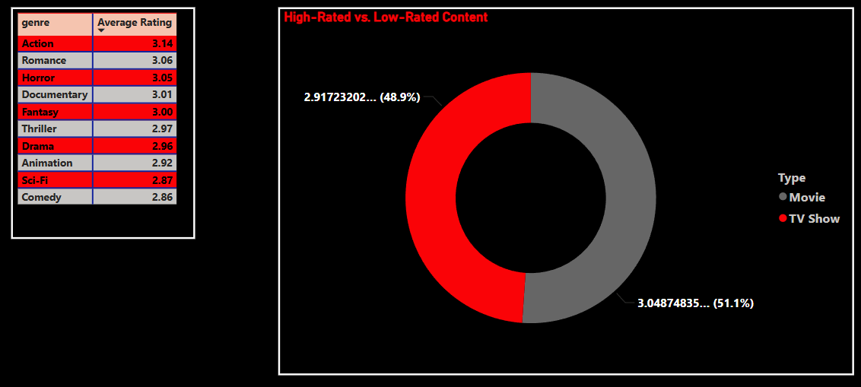
High-Rated vs. Low-Rated Content

Slide 22
Action genre has the highest rating among all genres with 3.14.
Comedy genre has the lowest rating with 2.86.
Insights:
Invest more in action genre to boost viewer satisfaction and engagement.
Analyze and improve comedy content to raise its appeal and ratings.
Movies have the highest average rating at 51.1%.
TV shows have the lowest average rating at 48.9%.
Insights:
Focus on producing high-quality movies to leverage their higher viewer ratings and attract subscribers.
Enhance TV show content and promotion to close the rating gap and increase viewer engagement.

Slide 23
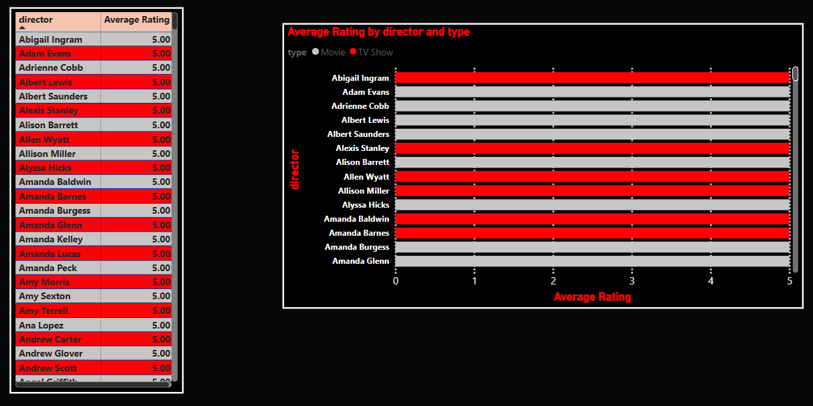
Top Directors by User Ratings

Slide 24
The following is a list of top directors who have received the highest customer ratings, ranking in the top five for both TV shows and movies.
Top directors with 5-star ratings boost viewer loyalty and engagement.
Lower-rated directors should improve content using audience feedback.
Training and collaboration can enhance overall quality.
Promoting top directors strengthens brand image and attracts subscribers.

Slide 25
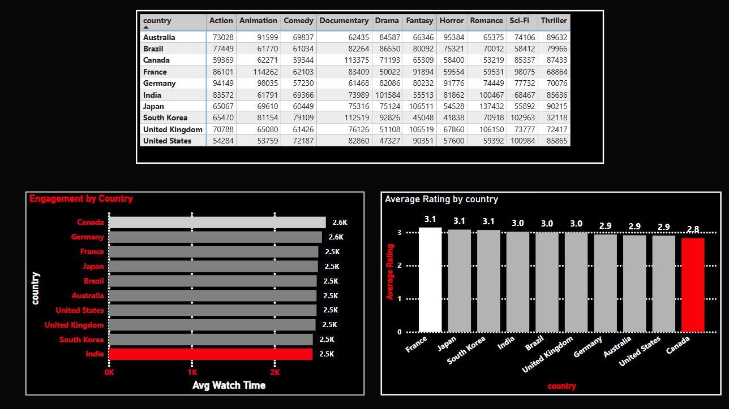
Country-wise Performance Analysis

Slide 26
India has the lowest watch time among the countries analyzed.
Canada has the lowest customer ratings despite decent watch time.
Australia has both low watch time and low customer ratings.
Insights:
India:
Add regional language films like Hindi, Tamil, or Telugu to attract local viewers.
Include popular Bollywood dramas and reality shows to boost engagement.
Canada:
Introduce diverse drama series reflecting multicultural stories to raise interest.
Add award-winning documentaries and indie films to improve viewer ratings.
Australia:
Invest in fresh comedy series with local humor to attract younger audiences.
Produce gripping thriller originals to capture more watch time and higher ratings.
Overall:
Run targeted ads on platforms like Facebook and YouTube to reach specific demographics.
Conduct viewer surveys and feedback sessions to refine content strategies continuously.

Slide 27
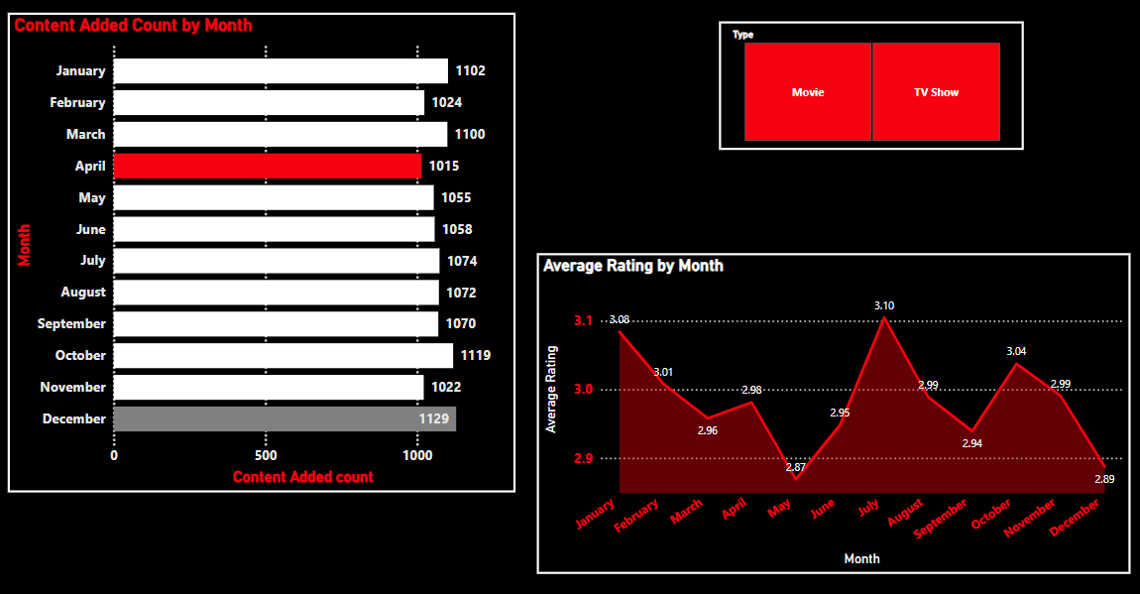
Content Release Timing Analysis

Slide 28
December is the highest release Movie/TV Shows while April has the lowest one, but July is the month with best or highest ratings compared to others
Insights:
July – Best Rated Month:
Prioritize premium content releases in July, as it receives the highest user ratings. High engagement this month offers a strong opportunity to boost brand perception and retention.
December – Peak Release Month:
Leverage December for mass releases during the holiday season when viewership spikes. Consider launching sequels or big titles to capitalize on festive binge-watching behavior.
April – Lowest Content Release:
Fill the content gap in April by introducing fresh or experimental shows. Lower competition allows new titles to stand out and attract dedicated viewers.

Slide 29
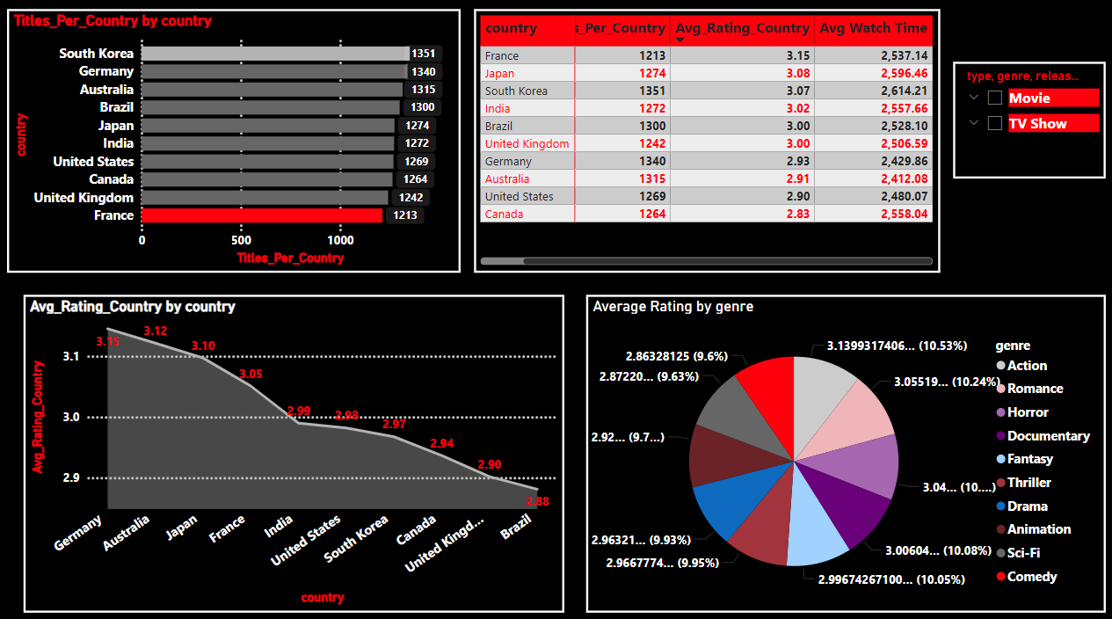
Customer Engagement Dashboard

Slide 30
Top Country (Overall Engagement): South Korea – High number of titles, high ratings, and high watch time.
Lowest Country (Engagement): Canada – Many titles, but lower ratings and average watch time.
Top Rated Genre: Action – Slightly higher average rating.
Lowest Rated Genre: Comedy/Horror – Slightly lower average ratings.
Insights:
Focus on High-Engagement Markets
South Korea shows strong performance in titles, ratings, and watch time.
Action: Invest more in local content and marketing to grow these satisfied audiences.
Improve in Lower-Performing Markets
Canada and Germany have many titles but lower engagement (ratings/watch time).
Action: Study local preferences and adjust content or recommendations accordingly.

Slide 31
Boost High-Rated Genres
Action and Romance genres receive slightly better ratings than others.
Action: Prioritize creating or promoting strong titles in these genres.
Leverage Release Timing (Future Insight)
Use the release_year filter to find when movie releases perform best.
Action: Time future releases for peak engagement.
Fix Rating Discrepancies
Rating numbers vary between visuals (e.g., France vs. Germany).
Action: Ensure data consistency for accurate decisions.
Netflix should double down on markets with strong engagement, optimize content for lower-rated countries, and focus on top-performing genres

Slide 32
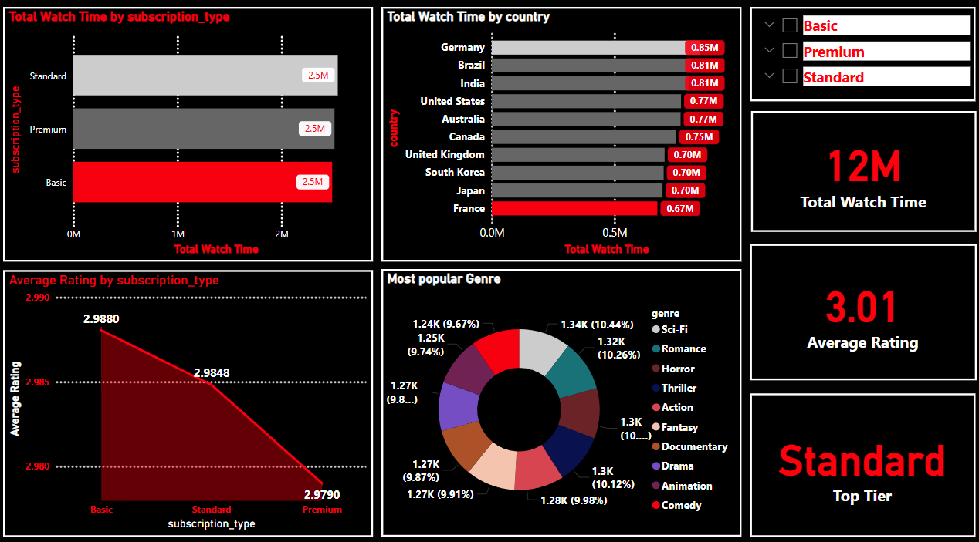
Improving with Competitive Insights

Slide 33
Equal Watch Time Across Plans
Basic, Standard, and Premium users all contribute almost equally to total watch time (~2.5M each).
Insight: Content engagement is strong regardless of subscription tier.
Top Countries by Watch Time
Germany, Brazil, and India lead in total watch time (~0.85M mins).
Insight: These countries show high engagement potential.
Slight Dip in Ratings by Tier
Ratings decrease slightly from Basic (2.99) to Premium (2.97).
Insight: Premium users may have higher expectations or different preferences.
Genre Engagement is Balanced
Top genres like Romance, Sci-Fi, Horror, Thriller, Action, and Drama each hold ~10% share.
Insight: Diverse content is engaging users evenly across genres.
Standard Plan Possibly Most Subscribed
Label “Standard - Top Tier” may suggest Standard is the most popular choice.
Insight: Focus marketing or added value on the Standard plan to retain and attract users.
Netflix enjoys balanced user engagement across all subscription tiers and genres. Strong watch time in Germany, Brazil, and India signals regional growth opportunities. Slight dips in ratings by tier highlight areas to enhance Premium user satisfaction.

Slide 34
Recommendations for Business Growth
Tailor Content by Age Group Develop curated content for older audiences and boost engagement with youth through fresh, relevant programming and features.
Optimize Subscription Plans Highlight the value of mid-tier plans and improve entry-level offerings to reduce churn and increase usage.
Focus on High-Performing Content Invest more in content types and genres that consistently drive engagement, while enhancing underperforming areas.
Localize for Regional Growth Expand popular content in high-performing regions and tailor offerings in low-engagement markets to meet local tastes.
Strategically Time Releases Launch major titles during peak engagement periods and use quieter months to test new content.

Slide 35
6.Personalize the Viewer Experience Offer smart recommendations to new and frequent users to boost retention and satisfaction.
7.Promote Top Creators Leverage high-rated directors and improve content quality based on audience feedback.
8.Refine Marketing Tactics Use targeted promotions and ongoing feedback to align content with audience expectations.

Slide 36
Conclusion
The platform performs well overall, but growth can be accelerated by improving content relevance, enhancing plan value, and personalizing user experiences. These actions will drive deeper engagement, satisfaction, and long-term loyalty.

Slide 37

THANK YOU

